Slide 1
Task 4
IPL Data Analysis in Tableau

Slide 2
Project Brief
The Indian Premier League, or IPL, is a T20 cricket league, which was founded in 2008 and is held every year. It sees participation from both national and international players, and eight teams representing eight Indian cities compete with each other in a double round-robin format in the league stages, which are followed by playoffs. Over the years, IPL has become one of the most-watched and most attended live sporting events all over the world.
This dataset includes 2 datasets viz., matches and deliveries.
Combining the information in these two data sets, I have created an interactive dashboard that highlights some of the important statistics of IPL over the years.
The first dataset maches.csv contains match level information for each and every match held in IPL from 2008 to 2017
The second dataset deliveries.csv contains ball-by-ball information for each of the matches.

Slide 3
The assignment is divided into three sub tasks which are as follows.
Match Statistics
Player Statistics
Team Statistics

Slide 4
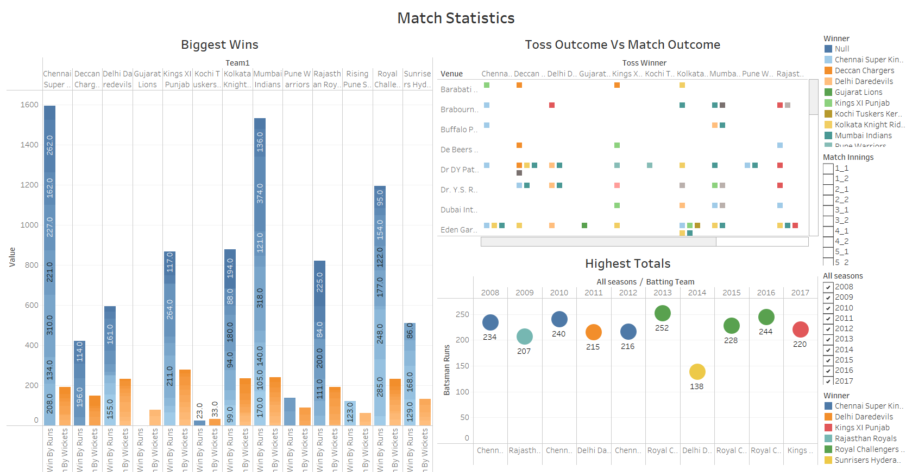

Slide 5
Match Statistics
You can see a bar graph describing each team that won the game by runs and wickets in the slide above. As you can see, the Chennai Super Kings won one game by 70 runs and another by 35 wickets in 2008.The same way from 2008 to 2017, the graph depicts the win by runs and wickets of each Indian Premium League team.
The next graph in the above slide describes the toss winner and the match winner. It varies with many teams winning the toss, however they end up losing the match.
The final graph depicts highest totals in every season from 008 to 2017. As you can see, in 2008, CSK scored the highest runs in the season by making a total of 234 runs. Similarly, in 2017, Kings X1 Punjab scored the highest runs in the season with 220.

Slide 6
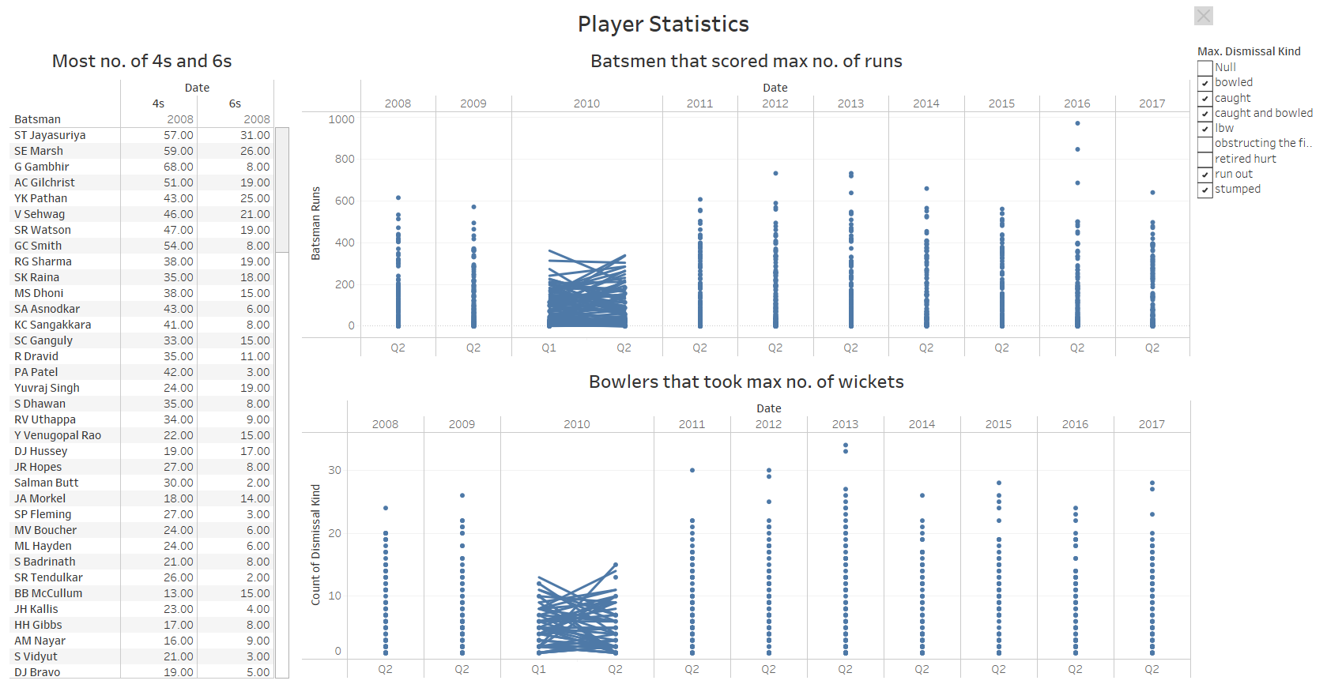

Slide 7
Player Statistics
The above slide describes about the Player Statistics such as who scored more runs in all the seasons.
Orange Cap contenders (The batsmen who have scored the maximum number of runs in a particular season)
Purple Cap contenders (The bowlers who have taken the maximum number of wickets in a particular season)
Batsmen who have hit the most number of fours and sixes (per season and overall)

Slide 8
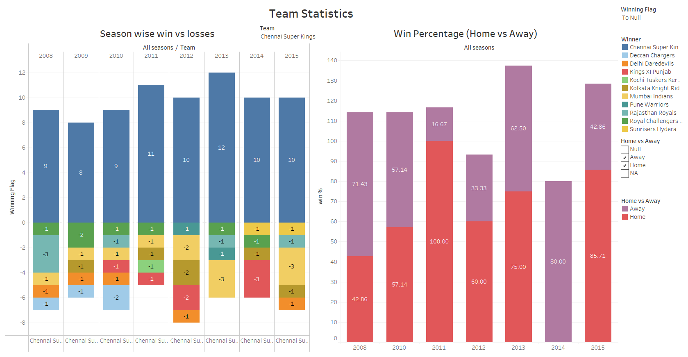

Slide 9
Team Statistics
The final slide describes about the Team Statistics such as season wise team performance and winning percentage of each team all over the seasons.
I have considered CSK to describe the team statistics. In 2008, the team has won 9 matches, in which 71.43 % of matches were won in home cities and the rest were away wins.
Similarly you can scroll through each team, and dashboard will show you the team total winnings and home vs away winning percentage from 2008 to 2017.

